Slide 1
Introduction to Operating System –Linux
Shreya Bokare

Slide 2
Introduction to Operating System
A program that acts as an intermediary between a user of a computer and the computer hardware
Operating system goals:
Execute user programs and make solving user problems easier
Make the computer system convenient to use
Use the computer hardware in an efficient manner

Slide 3
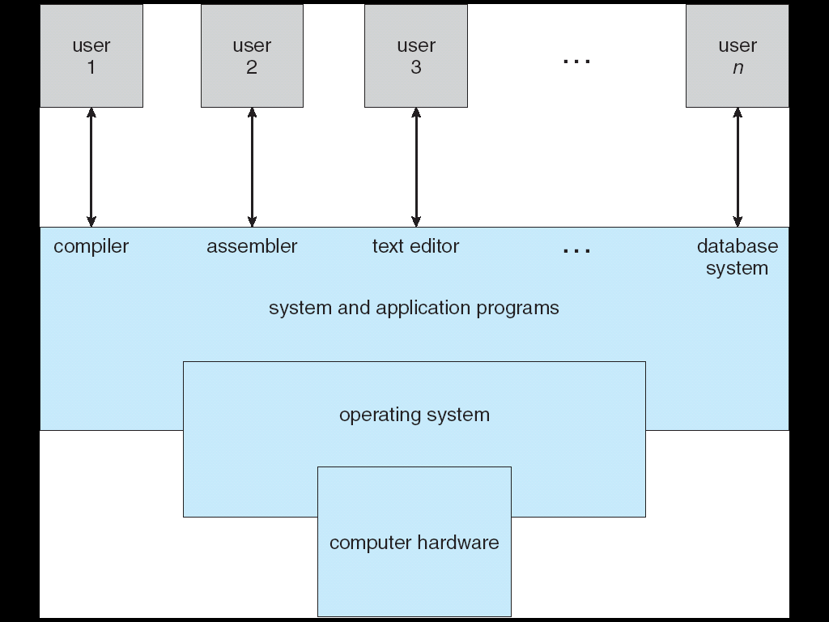
Computer System Components

Slide 4
What Operating Systems Do
Depends on the point of view
Users want convenience, ease of use
Don’t care about resource utilization
But shared computer such as mainframe or minicomputer must keep all users happy
Users of dedicate systems such as workstations have dedicated resources but frequently use shared resources from servers
Handheld computers are resource poor, optimized for usability and battery life
Some computers have little or no user interface, such as embedded computers in devices and automobiles

Slide 5
Operating System Definition
OS is a resource allocator
Manages all resources
Decides between conflicting requests for efficient and fair resource use
OS is a control program
Controls execution of programs to prevent errors and improper use of the computer
“The one program running at all times on the computer” is the kernel. Everything else is either a system program (ships with the operating system) or an application program

Slide 6
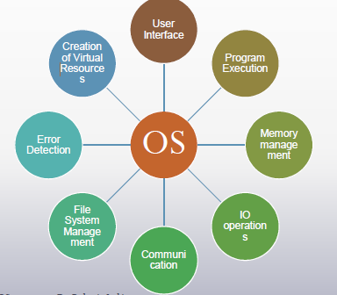
OS Functionalities

Slide 7
Computer Startup
Bootstrap program is loaded at power-up or reboot
Typically stored in ROM or EPROM, generally known as firmware
Initializes all aspects of system
Loads operating system kernel to memory and starts execution

Slide 8
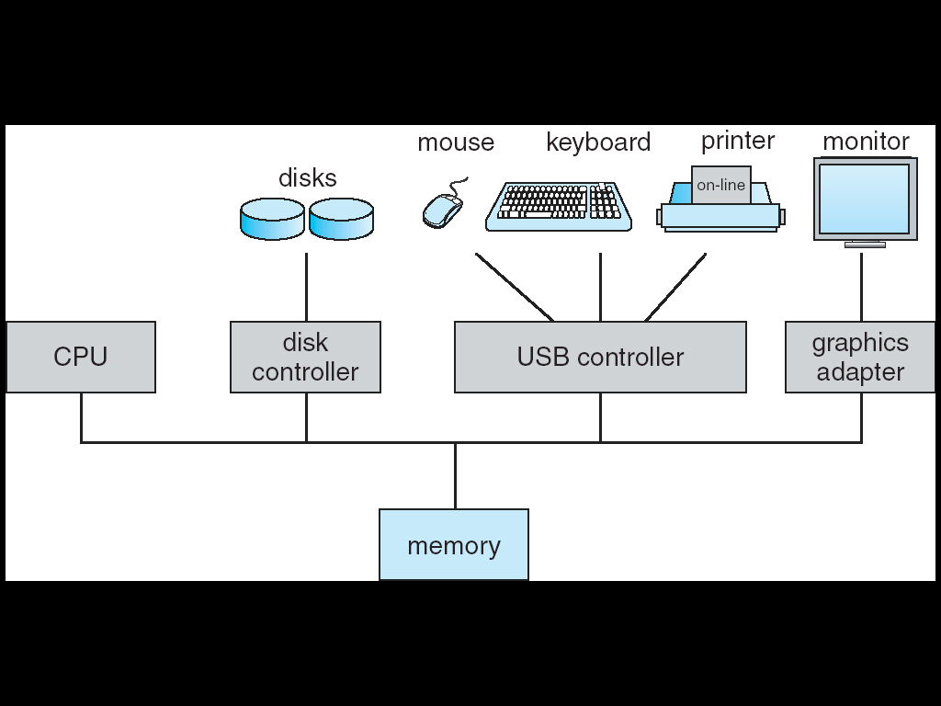
Computer System Organization
A computer system consists of
One or more CPUs and a number of device controllers connected through a common bus providing access to shared memory
The CPU and the device controllers execute concurrently, thereby competing for memory cycles

Slide 9
Computer-System Operation
I/O devices and the CPU can execute concurrently
Each device controller is in-charge of a particular device type
Each device controller has a local buffer
CPU moves data from/to main memory to/from local buffers
I/O is from the device to local buffer of controller
Device controller informs CPU that it has finished its operation by causing an interrupt

Slide 10
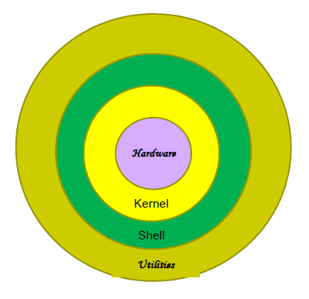
Operating System Components

Slide 11
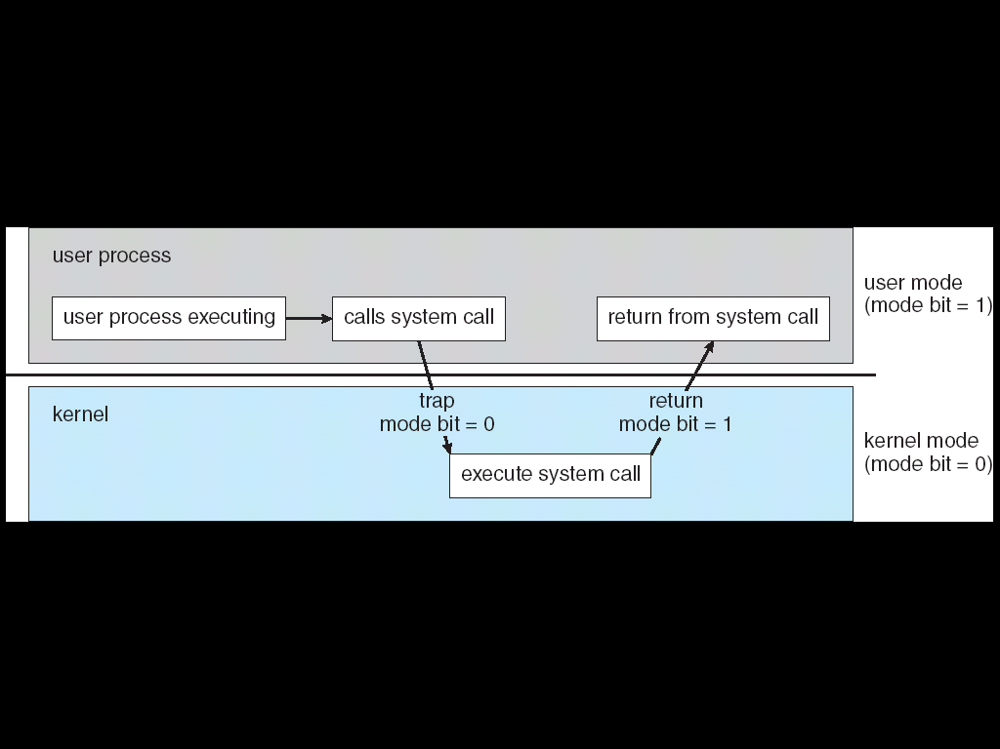
Operating-System Operations
Dual-mode operation allows OS to protect itself and other system components
User mode and kernel mode

Slide 12
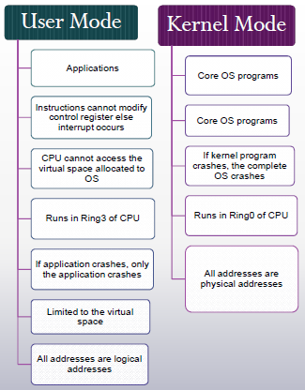

Slide 13
Kernel Space and User Space
Kernel space (privileged) is strictly reserved for Kernel programs and device drivers
User space (unprivileged) is used by user applications and will be swapped in and out as and when necessary

Slide 14
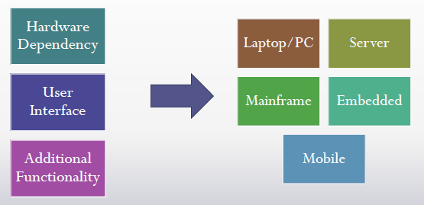
Types of Operating System

Slide 15
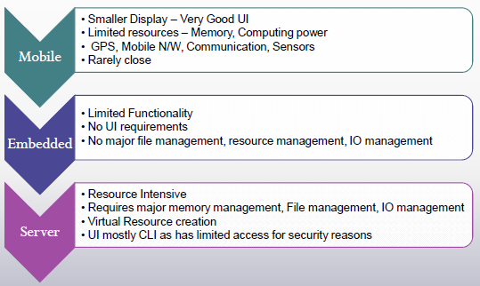
Types of Operating System

Slide 16
Linux

Slide 17

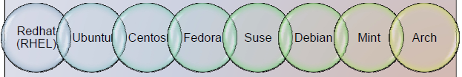
What is Linux
Open Source Operating System
Developed by Linus Torvalds, in 1991
Security Conscious
More popular for Server OS
Popular Customization - Android

Slide 18
Linux Components
Desktop Environment
GNOME, KDE,
Kernel
Core of OS
Daemons
Background processes /
Shell
Command Line interface
Manages CPU Memory , Peripheral Devices
services
Cinnamon, Unity
BASH, KSH, C

Slide 19
File System
Windows
Files are stored in different drives – C:,D:, E: etc
Linux
Everything is file in Linux e.g. directories, devices like printers, mouse, keyboard etc.
root /
directories
bin
lib
lost+found
mnt
opt
root
sbin
var
boot
dev
etc
proc
home
tmp
usr
file
…
dlun
guest
bin
lib
local
fd
hd
hd
group
passwd

Slide 20
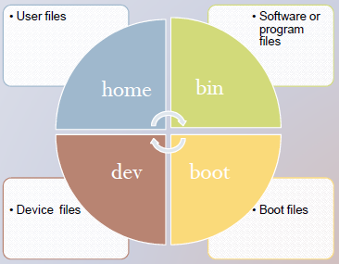
Linux File system

Slide 21
Users
Linux has Three types of users
Regular - all files are stored under /home. Regular users are not allowed to access files of other users.
Administrative (root)- known as a superuser. Has all administrative privileges such as installation of software, making changes to the file system.
Service User – Linux runs various services such as apache, Squid, email etc and provides the access to selective users. This account type is available only in the server version.

Slide 22
Metacharacters
* - any number of characters from 0 onwords
? - One character
. – Hidden files

Slide 23
Directory Management
pwd - current working directory
To go to home directory- $ cd ~
To go to the home directory of a particular user
$ cd ~username
To go to your last directory- $ cd ../
Make or create directory - mkdir
Delete directory - rmdir
Rename directory - mvdir

Slide 24
Commands on files
Creating new file
cat > <filename>
…
…
cntrl + d
View file - cat <filename>
Combining or merging two files
cat <file1> <file2> > <merged file>

Slide 25
Commands related to Files
Copy a file – cp <file1> <file2>
Del a file - rm <file1>
Rename a file – mv <file1> <file2>
Create an alias of a file - ln <source> <target>
View the contents of the file – cat <filename>
Print file – pr <filename>
Merge files – cat file1 file2 > file3
Sort a file - sort <filename>

Slide 26
More File Commands
Compare files – cmp <file1> <file2>
Search file for a keyword – grep regular_expr filename
Count lines/words/characters in a file – wc [option] filename {-l : lines ; -w : words; -c: characters}
tail [option] <filename>- display last few lines of the file
head [option] <filename> - Display top few lines of the file

Slide 27
Redirection
tee: <cmd>|tee <output file >
>
>> - append
< input

Slide 28
File Permission
Owner permissions
Group Permissions
Other Permissions
Permission Indicators
read (r), write (w), execute (x)

Slide 29
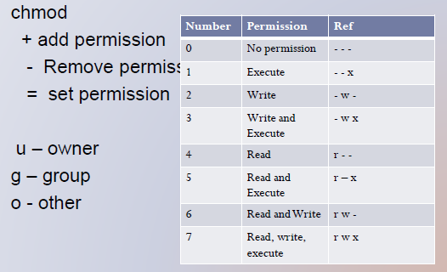
Changing Permissions
Change owner - chown
Change Group - chgrp

Slide 30
Pipes and Filters
grep - searches a file(s) for lines with certain pattern
$ grep pattern file(s)
Pipe allows to combine more than one command in a sequential order - |
e.g cat file | more to view the file screen by screen manner
Sorting contents of the file - sort

Slide 31
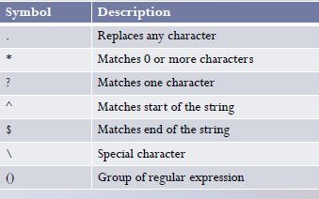
Regular Expressions

Slide 32
Environment Variable
When one logs into the system, shell undergoes a phase “initialization”, which involves reading files
/etc/profile
Profile
You can set the prompt in /etc/bash.bashrc
Setting up PATH
$ PATH=/bin:/usr/bin
PS1 – what should be the prompt on shell e.g
PS1=“[\u@\h \w]\$”
When an incomplete command is issued, the shell displays secondary prompt and waits for you to complete the command or press Enter
Default Secondary prompt is >
It is stored in PS2

Slide 33
Privileged Task
To convert the regular user permissions to root user permission to perform a privileged task
sudo

